Slide 1
HCDD 411: Client-Server Architecture
Md Touhidul Islam

Slide 2
Today's Goals
Understand How modern systems are built
Understand the client-server model
Explore each component one by one
See how everything works together

Slide 3
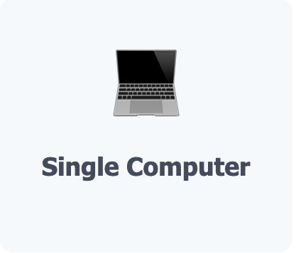
Evolution of Computing
1970s - 1980s: Standalone Computers
Everything stored locally. No sharing. No internet.

Slide 4
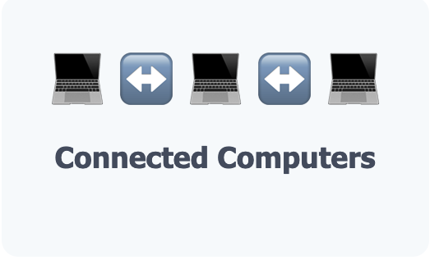
Evolution of Computing
1990s - 2000s: Networks & The Web Emerges
Computers connected via networks. Early websites. Dial-up internet.

Slide 5
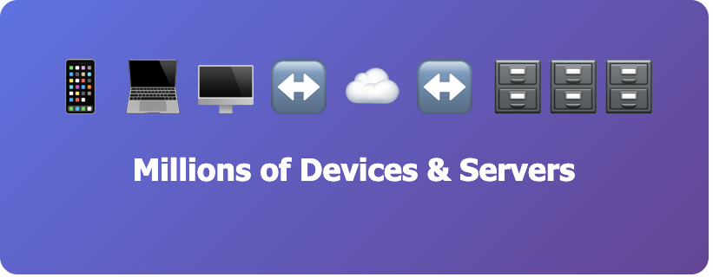
Evolution of Computing
This is what we will study in HCDD 411
Today: Distributed Systems
Modern applications don't run on a single computer. They're distributed across many computers, each with a specific role. This is called a distributed system.

Slide 6
The Client-Server Model
The most common way to organize a distributed system is the client-server architecture
It divides responsibilities into two main roles:
Client
Server

Slide 7
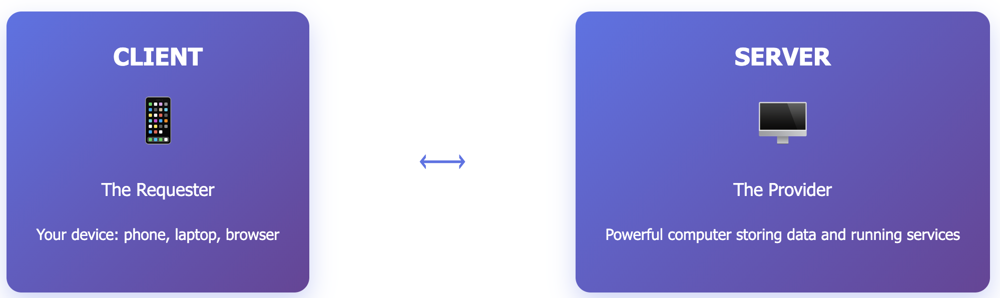
The Client-Server Model
You (The Client):
Look at the menu
Order your food
Wait to receive it
Enjoy your meal
Kitchen (The Server):
Has all the ingredients
Receives your order
Prepares the food
Sends it back to you
The client requests, the server responds. Simple as that!

Slide 8
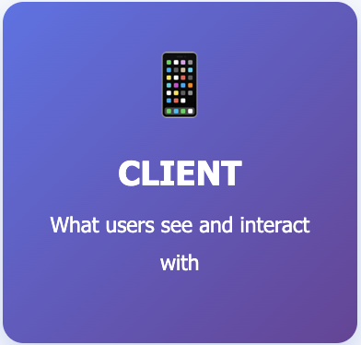
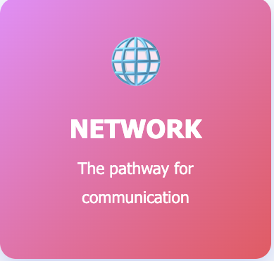
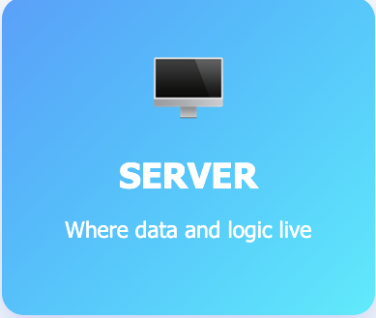
Three Essential Components
No matter how complex an application is, it always has these 3 parts:
Real Example: Checking Instagram
Client: Instagram app on your phone
Network: WIFI or cellular data connection
Server: Instagram's computers storing all the photos and user data

Slide 9
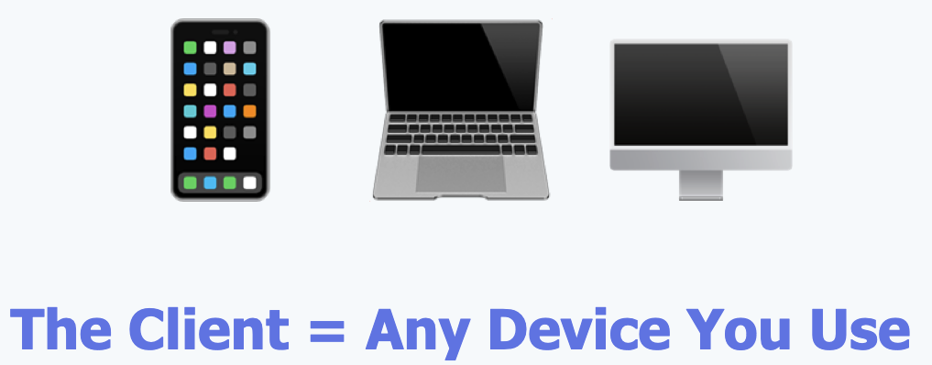
Component 1: The Client (Front-End)
What Users See and Touch
What Does the Client Do?
Displays information to users (text, images, videos)
Accepts user input (clicks, typing, touches)
Sends requests to the server when it needs data
Receives responses from the server and shows them

Slide 10
Component 1: The Client (Front-End)
Examples of Clients
Web browsers (Chrome, Safari, Firefox)
Mobile apps (Instagram, Gmail, Twitter)
Desktop applications
Smart TV apps
Technologies We'll Learn
HTML: Structure of web pages
CSS: Styling and layout
JavaScript: Interactivity
React: Building modern interfaces

Slide 11
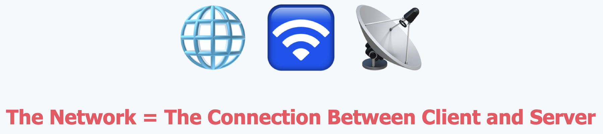
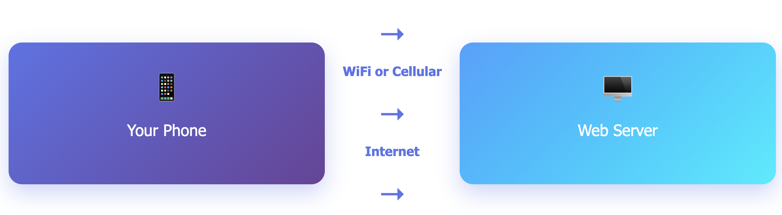
Component 2: The Network
The Highway for Data
What Does the Network Do?
Transmits requests from client to server
Carries responses from server back to client
Uses protocols (rules) to ensure data arrives correctly
Handles millions of messages simultaneously

Slide 12
The Protocol: HTTP/HTTPS
Just like humans speak different languages (English, Spanish, French), computers use protocols to communicate.
HTTP (HyperText Transfer Protocol) is the language of the web. It defines:
How to format requests and responses
What different types of requests mean (GET, POST, etc.)
How to handle errors

